Slide 1
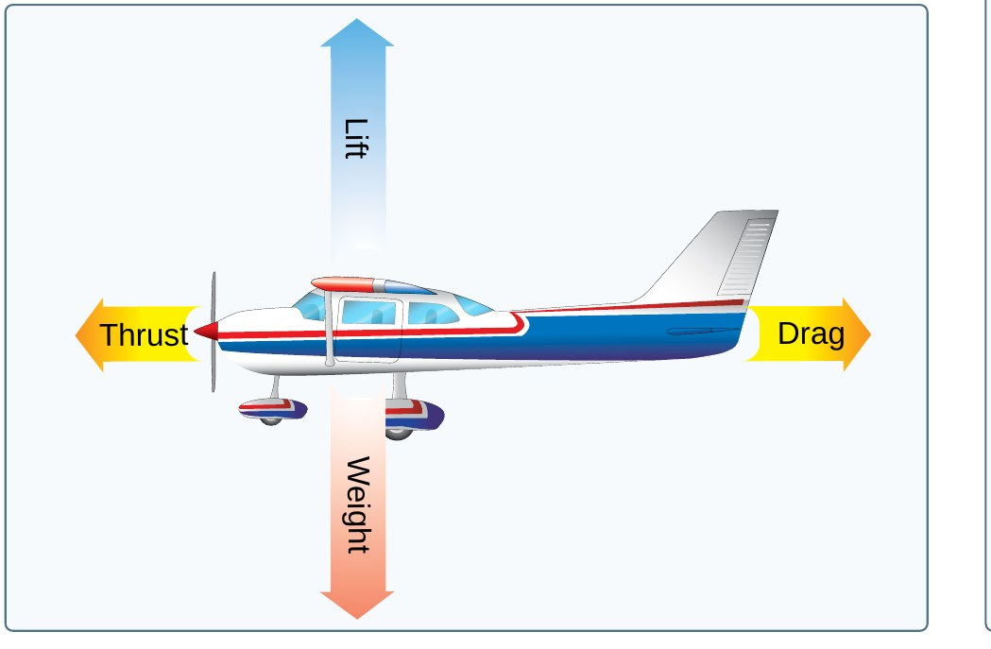
Principles of Flight
Area II: Technical Subject Areas
ACS Task II.D (AI.II.D)
Cessna 172S NAV III (G1000)
[Name], CFI Applicant
Source: PHAK Fig 5-1
1
Notes:
Attention: hold your hand out of a car window. Tilt it up and it rises. Today we explain exactly why, and how that one idea explains everything the airplane does.

Slide 2
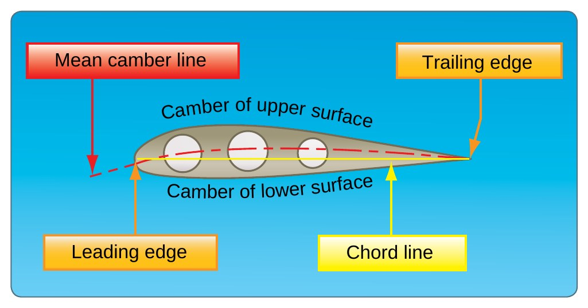
Objective
AI.II.D
Explain how a wing makes lift
Name the four forces and drag types
Explain stability and turning tendencies
Know load factor and wake turbulence
State the objective: the student will understand airfoil design, the four forces, stability, turning tendencies, load factors, and wingtip vortices, and will know how to manage the risks that come from them.
Source: ACS II.D
2
Notes:
By the end you will understand the aerodynamics behind every maneuver you fly, and you will be able to manage the risks that come with them.

Slide 3
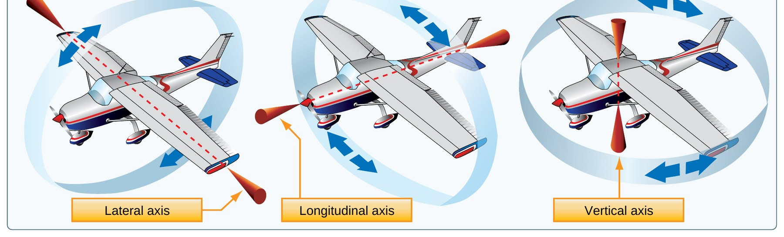
Lesson Roadmap: Each Topic Builds the Next
AI.II.D
Step | Topic | Leads to
1 | Airfoil and lift (K1) | What forces act?
2 | Four forces and drag (K4) | Induced drag makes vortices
3 | Wingtip vortices (K6) | Why it stays stable
4 | Stability and control (K2) | What pulls it off course?
5 | Turning tendencies (K3) | How hard can you pull?
6 | Load factors (K5) | Risk management (R1)
Show the roadmap. The order is chosen so each topic sets up the next: the wing makes lift; lift comes with forces and drag; induced drag makes wingtip vortices; then we ask why the airplane stays stable, what pulls it off course (turning tendencies), and how much load it can take. Risk management ties it all together.
Teaching the order this way follows the AIH idea of building from the known to the unknown and connecting each new idea to the last one.
NEXT UP
Start with step 1: how the wing makes lift.
Source: ACS II.D
3
Notes:
This is the map. Each topic answers a question, and that answer raises the next question. That is why we go in this order instead of the ACS number order.

Slide 4
Step 1 of 6 | AI.II.D.K1
Airfoil Design and Lift
What you will learn
Parts of an airfoil
Bernoulli and Newton
Relative wind and AOA
Critical AOA and the stall
Start here: everything else in this lesson comes from how the wing makes lift.
Source: PHAK 4-6 to 4-8, PHAK 5-4
4
Notes:
Section: Airfoil Design and Lift. Start here: everything else in this lesson comes from how the wing makes lift.

Slide 5
Definitions: Chord Line and Camber
AI.II.D.K1
CHORD LINE
“a straight line drawn through the profile connecting the extremities of the leading and trailing edges.”
CAMBER
“The camber of an airfoil is the characteristic curve of its upper and lower surfaces. The upper camber is more pronounced, while the lower camber is comparatively flat.”
TEACHING NOTE
The glossary adds that the curved upper camber makes the airflow above the wing much faster than below it (PHAK G-6).
Source: PHAK 4-6, PHAK G-6, PHAK Fig 4-5
5
Notes:
Point to each part on the figure: leading edge, trailing edge, chord line, upper and lower camber, mean camber line.

Slide 6
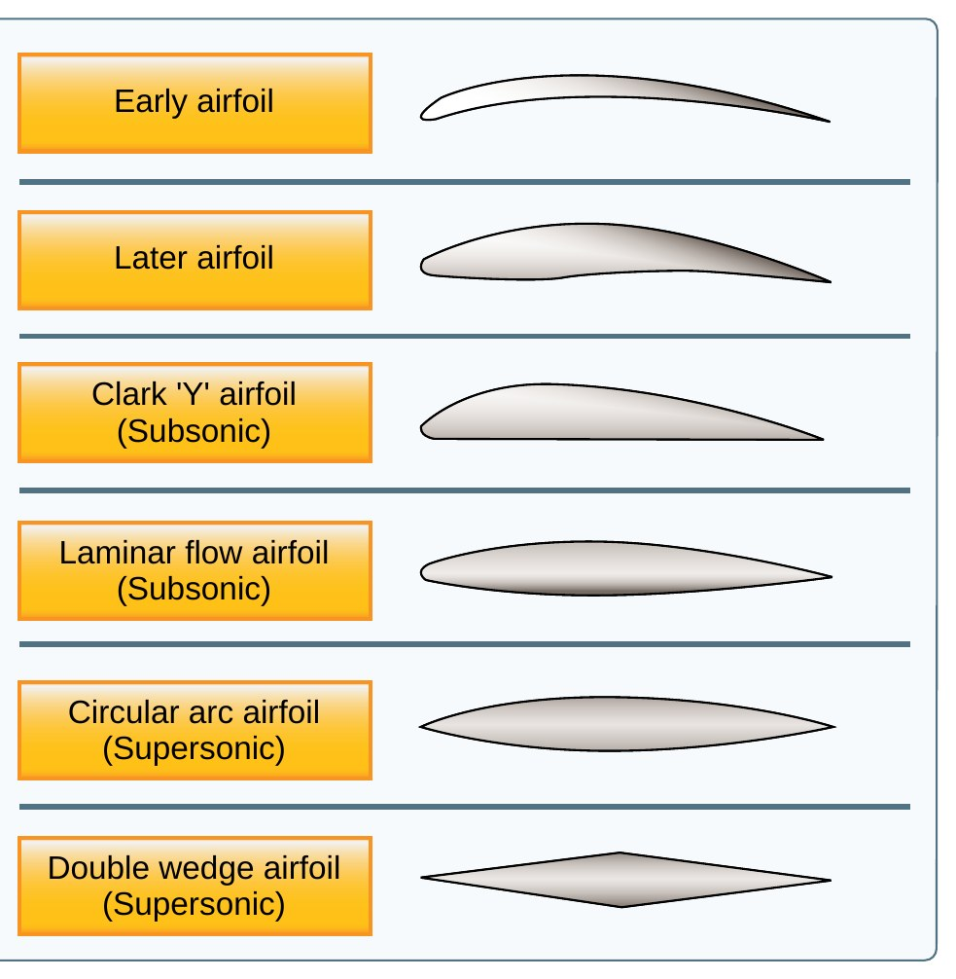
Airfoil Design Characteristics
AI.II.D.K1
Shape is built to make lift
Thick, curved: good at low speed
Thin: better for high speed
Every design is a tradeoff
An airfoil is shaped to take advantage of the air's response to physical laws, giving a positive pressure lifting action from below and a negative pressure lifting action from above (PHAK 4-7).
Figure 4-6 shows the progression from early airfoils to laminar flow and supersonic shapes. Each design is chosen for the airplane's purpose.
Source: PHAK 4-6, PHAK 4-7, PHAK Fig 4-6
6
Notes:
No one airfoil does everything. Airfoils for slow flight and short takeoffs have more curve; fast airplanes use thinner shapes.

Slide 7
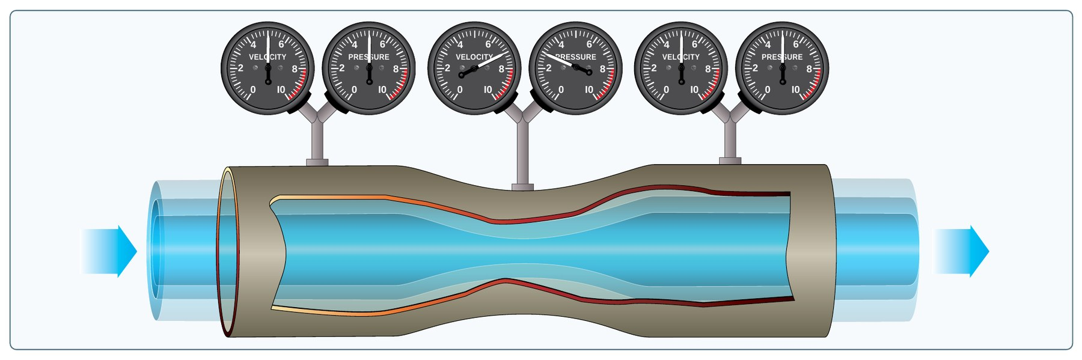
Definition: Bernoulli's Principle
AI.II.D.K1
BERNOULLI'S PRINCIPLE
“as the velocity of a moving fluid (liquid or gas) increases, the pressure within the fluid decreases.”
IN PLAIN WORDS
Air speeds up over the curved top of the wing, so the pressure there drops. Higher pressure underneath pushes the wing up.
MEMORY AID
Speed up, pressure down.
Source: PHAK 4-6, PHAK Fig 4-4
7
Notes:
The venturi tube shows it: the air speeds up in the narrow part and the pressure gauge there reads lower.

Slide 8
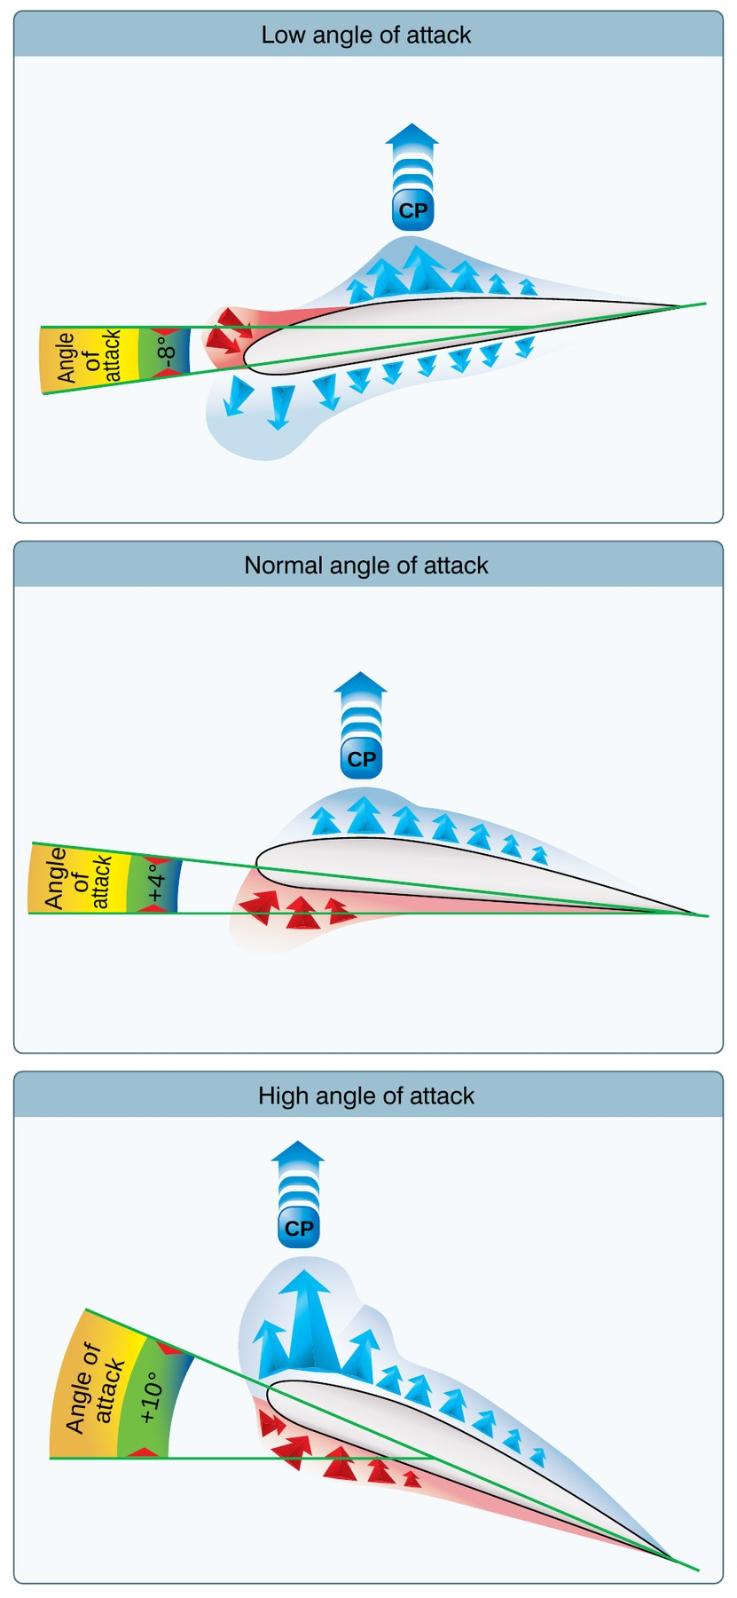
Newton's Third Law and Downwash
AI.II.D.K1
Equal and opposite reaction
Wing pushes air down
Air pushes wing up
Both laws work together
Newton's Third Law: "For every action, there is an equal and opposite reaction" (PHAK 4-3).
The downward backward flow from the top surface creates a downwash. Applying Newton's third law, the reaction to this downward backward flow is an upward forward force on the airfoil (PHAK 4-8).
Both Bernoulli's Principle and Newton's Laws are in operation whenever lift is being generated (PHAK 4-8). Figure 4-7 shows the pressure pattern changing as AOA changes.
Source: PHAK 4-3, PHAK 4-8, PHAK Fig 4-7
8
Notes:
The downwash leaving the trailing edge is the action. The upward force on the wing is the reaction. Bernoulli and Newton are both happening at the same time.

Slide 9
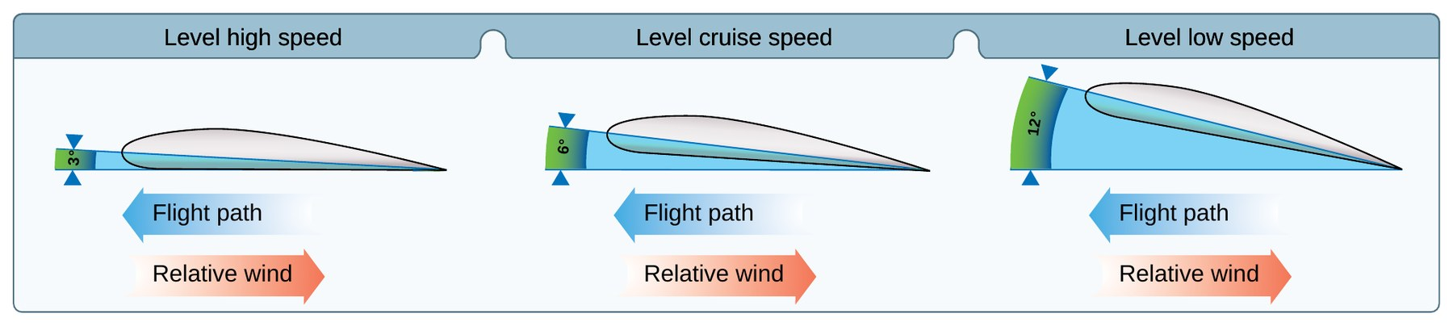
Definitions: Relative Wind and Angle of Attack
AI.II.D.K1
RELATIVE WIND
“Direction of the airflow produced by an object moving through the air. The relative wind for an airplane in flight flows in a direction parallel with and opposite to the direction of flight.”
ANGLE OF ATTACK
“the angle at which relative wind meets an airfoil. It is the angle that is formed by the chord of the airfoil and the direction of the relative wind or between the chord line and the flight path.”
KNOW THIS FOR THE CHECKRIDE
Lift always acts perpendicular to the relative wind, and the relative wind comes from the flight path, not the nose.
TEACHING NOTE
Lift is perpendicular to the relative wind (PHAK 5-8), which your whiteboard notes also show.
Source: PHAK G-25, PHAK G-3, PHAK Fig 5-3
9
Notes:
Relative wind comes from the flight path, not from where the nose points. AOA is the angle between the chord line and that relative wind.

Slide 10
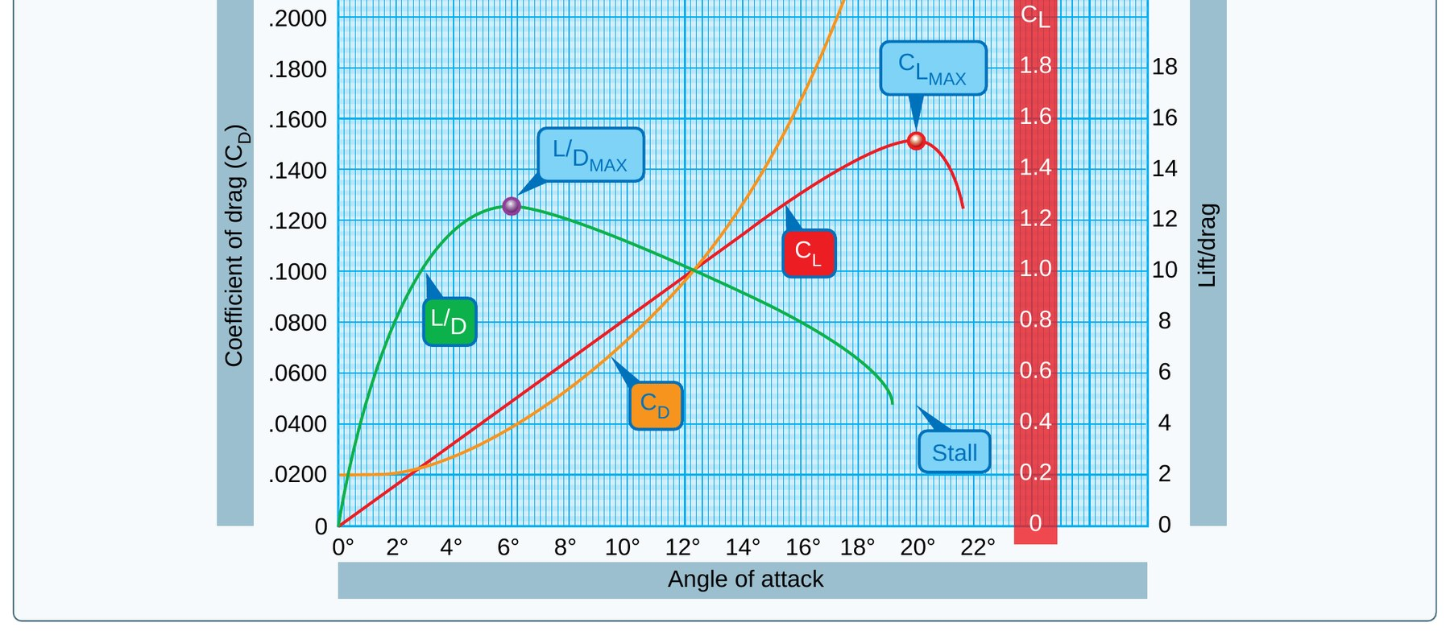
Lift, Speed, and AOA
AI.II.D.K1
Lift: proportional to speed squared
Double speed: four times lift
Slower: need higher AOA
Pilot controls lift with AOA
Lift is proportional to the square of the velocity. An airplane at 200 knots has four times the lift of the same airplane at 100 knots, if AOA and other factors stay the same (PHAK 5-4).
The lift equation is L = CL x density x V squared x S, divided by 2 (PHAK 5-4). The pilot controls lift mainly by changing AOA and airspeed.
Figure 5-5 shows the coefficient of lift rising with AOA until it peaks, then falling off: that is the stall.
KNOW THIS FOR THE CHECKRIDE
Lift is proportional to the square of the velocity. Twice the speed, four times the lift (PHAK 5-4).
Source: PHAK 5-4, PHAK Fig 5-5
10
Notes:
L = CL x rho x V squared x S, divided by 2. Speed is squared, so it has a big effect. Slow down and you must raise the AOA to keep the same lift.

Slide 11
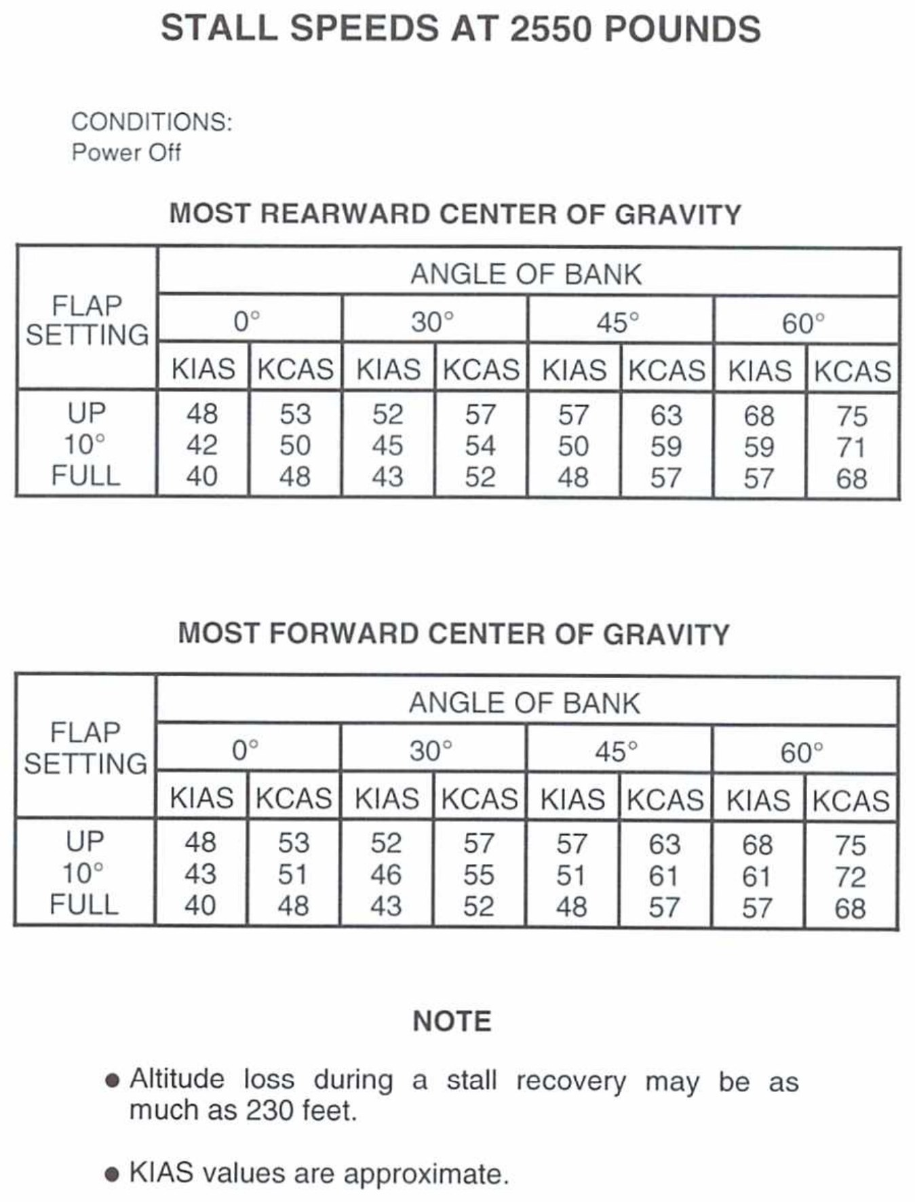
Definition: Critical Angle of Attack
AI.II.D.K1
CRITICAL ANGLE OF ATTACK
“The angle of attack at which a wing stalls regardless of airspeed, flight attitude, or weight.”
IN PLAIN WORDS
A wing stalls because the AOA is too high, not because the airspeed is too low. Stall speed changes with weight, bank, and flaps. The critical AOA does not.
Source: PHAK G-9, POH Fig 5-3
11
Notes:
The C172S stall speed table proves it: same wing, different stall speeds depending on flaps and bank.

Slide 12
Quick Check
AI.II.D.K1
1
State Bernoulli's Principle.
Answer: As the velocity of a moving fluid increases, the pressure within the fluid decreases (PHAK 4-6).
2
If you double your airspeed at the same AOA, what happens to lift?
Answer: It becomes four times as much (PHAK 5-4).
3
Can a wing stall at high airspeed?
Answer: Yes. It stalls at the critical AOA regardless of airspeed, attitude, or weight (PHAK G-9).
NEXT UP
Next up, the four forces. The wing makes lift, but lift never comes alone. What else is acting on the airplane?
Source: PHAK 4-6, PHAK 4-8, PHAK 5-4, PHAK G-9
12
Notes:
Ask each question and let the student answer before showing the answer. Q1: State Bernoulli's Principle. A: As the velocity of a moving fluid increases, the pressure within the fluid decreases (PHAK 4-6). Q2: If you double your airspeed at the same AOA, what happens to lift? A: It becomes four times as much (PHAK 5-4). Q3: Can a wing stall at high airspeed? A: Yes. It stalls at the critical AOA regardless of airspeed, attitude, or weight (PHAK G-9).

Slide 13
Step 2 of 6 | AI.II.D.K4
Forces Acting on an Airplane
What you will learn
Thrust, drag, lift, weight
Forces in balance and in a climb
Parasite drag: form, interference, skin friction
Induced drag and L/D max
Coming from step 1: the wing makes lift, but lift never comes alone. Here are the forces that come with it.
Source: PHAK 5-1 to 5-8
13
Notes:
Section: Forces Acting on an Airplane. Coming from step 1: the wing makes lift, but lift never comes alone. Here are the forces that come with it.

Slide 14
The Four Forces
AI.II.D.K4
Thrust: forward, from the prop
Drag: rearward, from airflow
Lift: perpendicular to flight path
Weight: down through the CG
Thrust: the forward force produced by the powerplant/propeller. It opposes or overcomes drag (PHAK 5-1).
Drag: a rearward, retarding force caused by disruption of airflow by the wing, fuselage, and other protruding objects (PHAK 5-1).
Lift: produced by the dynamic effect of the air acting on the airfoil, acting perpendicular to the flight path through the center of lift (PHAK 5-1).
Weight: the combined load of the aircraft, crew, fuel, and cargo, acting vertically downward through the CG (PHAK 5-2).
Source: PHAK 5-1, PHAK 5-2, PHAK Fig 5-1
14
Notes:
Thrust opposes drag. Lift opposes weight. In steady flight they cancel each other, but they are not all equal.

Slide 15
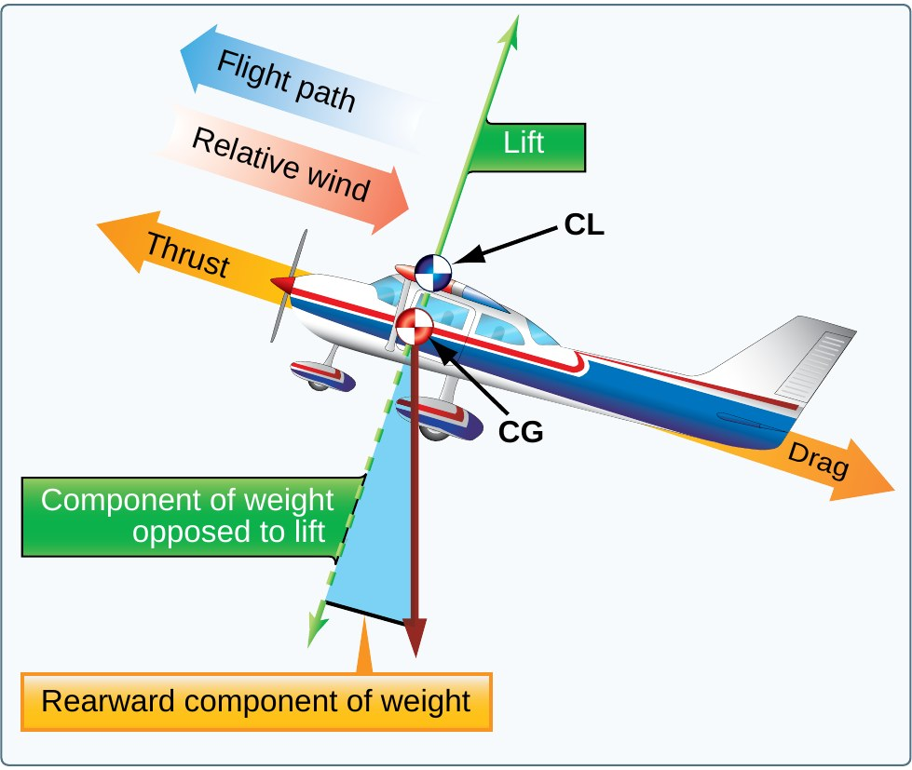
Forces in Balance and in a Climb
AI.II.D.K4
Steady flight: forces cancel
Not all four are equal
Lift and weight are larger
Climb: weight acts partly as drag
In steady flight, the sum of opposing forces is always zero. That does not mean the four forces are equal; it means the opposing forces cancel (PHAK 5-2).
In straight, level, unaccelerated flight, lift and weight are equal and are greater than thrust and drag, which are equal only to each other (PHAK 5-2).
Figure 5-2: in a climb, part of the weight acts rearward like drag, so more thrust is needed.
KNOW THIS FOR THE CHECKRIDE
Opposing forces cancel. Lift and weight are bigger than thrust and drag (PHAK 5-2).
Source: PHAK 5-2, PHAK Fig 5-2
15
Notes:
A common mistake is saying all four forces are equal. In steady flight, up equals down and forward equals back. In a climb, part of weight points backward like drag.

Slide 16
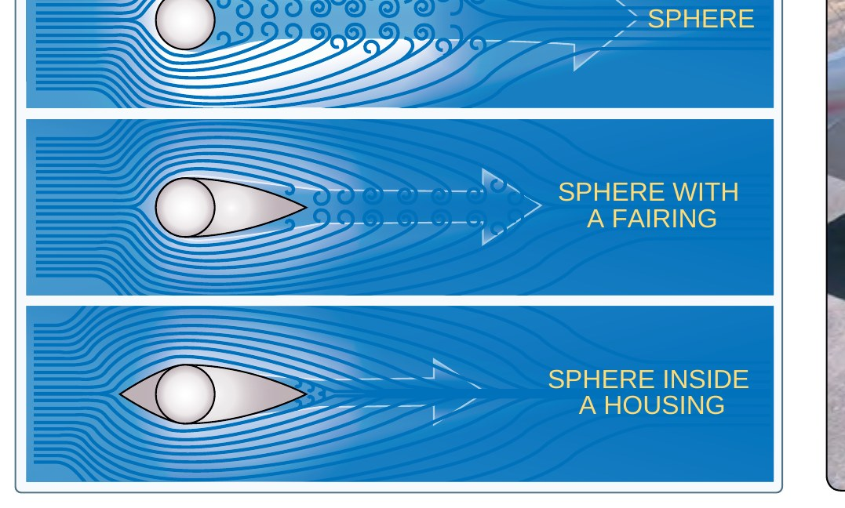
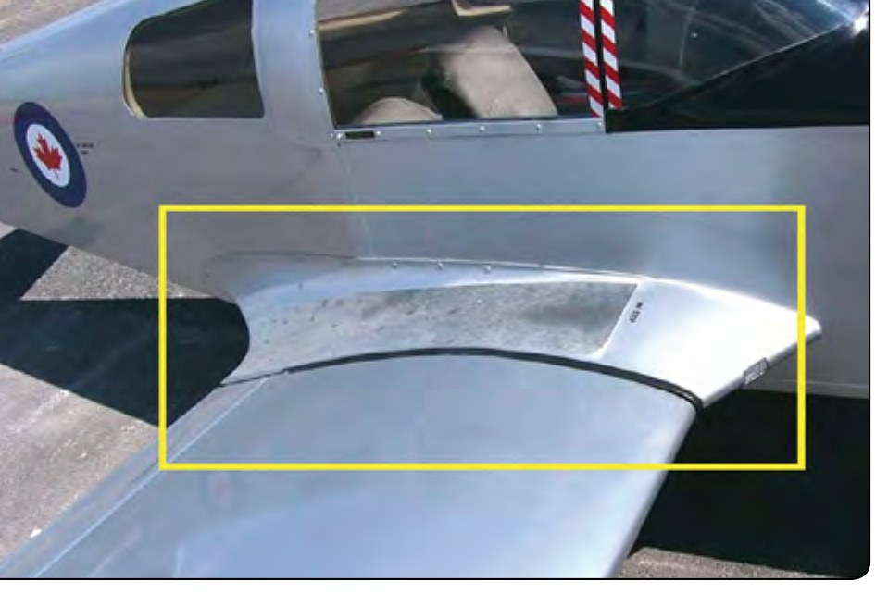
Definition: Parasite Drag
AI.II.D.K4
PARASITE DRAG
“Parasite drag is comprised of all the forces that work to slow an aircraft's movement. As the term parasite implies, it is the drag that is not associated with the production of lift.”
IN PLAIN WORDS
Three types: form drag (shape), interference drag (airstreams meeting, like wing and fuselage), and skin friction (rough surfaces, rivets, dirt).
Source: PHAK 5-6, PHAK Fig 5-7, PHAK Fig 5-8
16
Notes:
Form drag: the flat plate versus the streamlined shape. Interference drag: where the wing meets the fuselage or strut. Skin friction: rivets, paint chips, dirt.

Slide 17
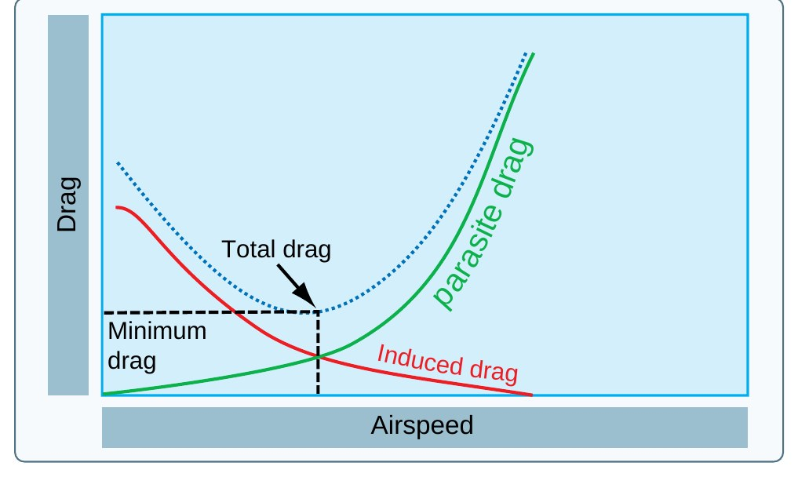
Induced Drag and the Drag Curve
AI.II.D.K4
Induced: comes from making lift
More AOA, more induced drag
Parasite rises with speed squared
L/D max: lowest total drag
Induced drag is inherent whenever an airfoil is producing lift and is inseparable from the production of lift (PHAK 5-7).
As AOA increases, induced drag increases. The lower the airspeed, the greater the AOA needed, so the greater the induced drag. Induced drag varies inversely with the square of the airspeed; parasite drag increases as the square of the airspeed (PHAK 5-8).
At L/D max, total drag is at its minimum (PHAK 5-5).
Note on your whiteboard: the PHAK says induced drag varies inversely with the square of airspeed and parasite drag increases as the square of airspeed, not just "inversely" and "directly."
KNOW THIS FOR THE CHECKRIDE
Induced drag: inversely with the square of airspeed. Parasite drag: as the square of airspeed (PHAK 5-8).
Source: PHAK 5-7, PHAK 5-8, PHAK 5-5, PHAK Fig 5-6
17
Notes:
Induced drag is highest when slow, parasite drag is highest when fast. Where the two curves cross is the bottom of the total drag curve: L/D max.

Slide 18
Quick Check
AI.II.D.K4
1
In straight and level flight, are all four forces equal?
Answer: No. Lift equals weight and thrust equals drag, but lift and weight are larger (PHAK 5-2).
2
Name the three types of parasite drag.
Answer: Form, interference, and skin friction (PHAK 5-6).
3
You slow down toward a stall. Which drag rises sharply?
Answer: Induced drag (PHAK 5-8).
NEXT UP
Next up, wingtip vortices. Induced drag comes from air spilling around the wingtip. Where does that air go?
Source: PHAK 5-2, PHAK 5-6, PHAK 5-8
18
Notes:
Ask each question and let the student answer before showing the answer. Q1: In straight and level flight, are all four forces equal? A: No. Lift equals weight and thrust equals drag, but lift and weight are larger (PHAK 5-2). Q2: Name the three types of parasite drag. A: Form, interference, and skin friction (PHAK 5-6). Q3: You slow down toward a stall. Which drag rises sharply? A: Induced drag (PHAK 5-8).

Slide 19
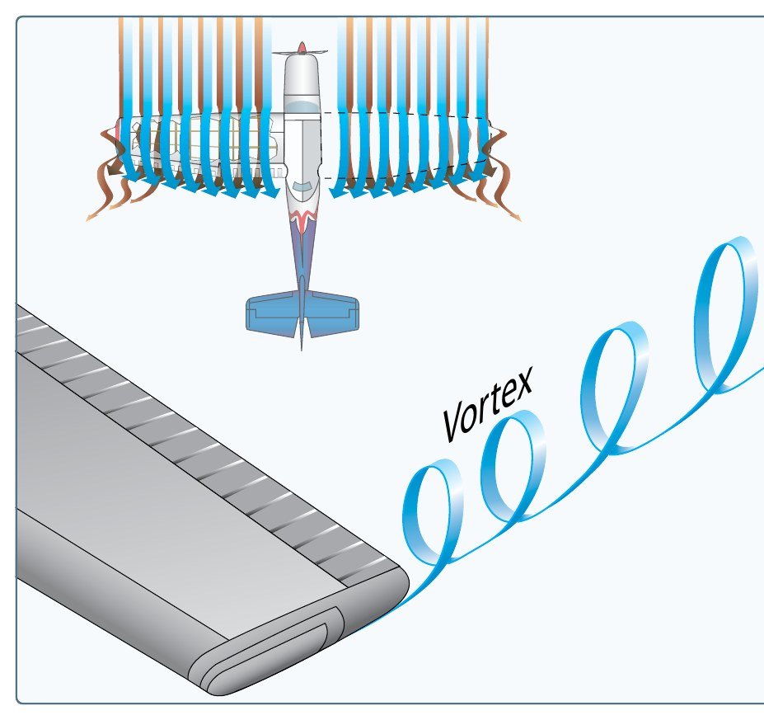
Step 3 of 6 | AI.II.D.K6
Wingtip Vortices
What you will learn
How vortices form
How they move and sink
Wake turbulence precautions
Coming from step 2: induced drag comes from air spilling around the wingtip. That spill is a wingtip vortex.
Source: PHAK 5-7 to 5-10, AIM 7-4
19
Notes:
Section: Wingtip Vortices. Coming from step 2: induced drag comes from air spilling around the wingtip. That spill is a wingtip vortex.

Slide 20
How Wingtip Vortices Form
AI.II.D.K6
High pressure under the wing
Air spills around the tip
Forms a spinning vortex
Strongest: heavy, clean, slow
Below the wing the pressure is higher than above it. The air flows from the high pressure area below the tip up to the low pressure area on top, creating vortices that trail behind the airfoil (PHAK 5-7).
As the air curls upward around the tip, it combines with the downwash to form a fast-spinning trailing vortex (PHAK 5-9). Your whiteboard note matches this wording.
Vortex strength is directly proportional to weight and inversely proportional to wingspan and speed. Strongest during takeoff, climb, and landing (PHAK 5-9).
Source: PHAK 5-7, PHAK 5-8, PHAK 5-9, PHAK Fig 5-12
20
Notes:
Same idea as induced drag: high pressure below, low pressure above, so air curls around the tip. That spinning air trails behind every airplane making lift.

Slide 21
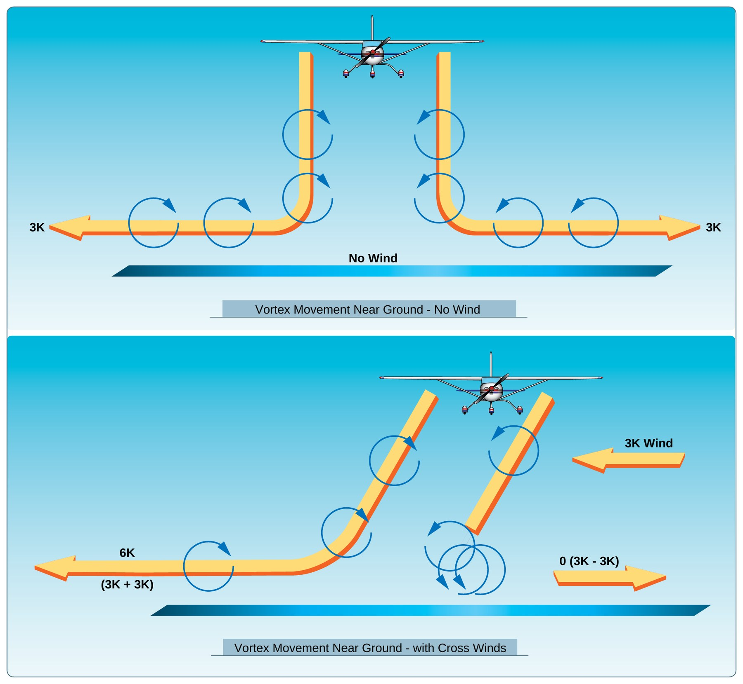
How Vortices Move
AI.II.D.K6
From rotation to touchdown
Sink several hundred fpm
Near ground: drift 2 to 3 knots
Light crosswind can hold one
An aircraft makes vortices from the moment it rotates on takeoff until touchdown, since they are a by-product of lift (AIM 7-4-4).
Vortices from larger aircraft sink several hundred feet per minute, slowing and weakening with time and distance (AIM 7-4-4).
Within 100 to 200 feet of the ground, they move laterally at 2 or 3 knots. A light crosswind of 1 to 5 knots can hold the upwind vortex in the touchdown zone (PHAK Fig 5-15).
Vortices drift with the wind. A 10 knot wind moves them about 1,000 feet in a minute (PHAK 5-9).
KNOW THIS FOR THE CHECKRIDE
A light quartering crosswind is the worst case. It can hold a vortex over the runway.
Source: AIM 7-4-4, PHAK 5-9, PHAK Fig 5-15
21
Notes:
A light quartering wind is the worst case: it can hold the upwind vortex right over the runway.

Slide 22
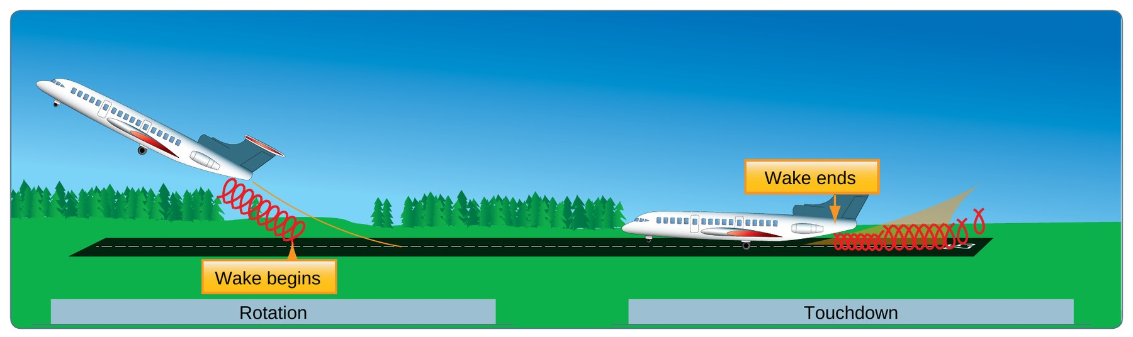
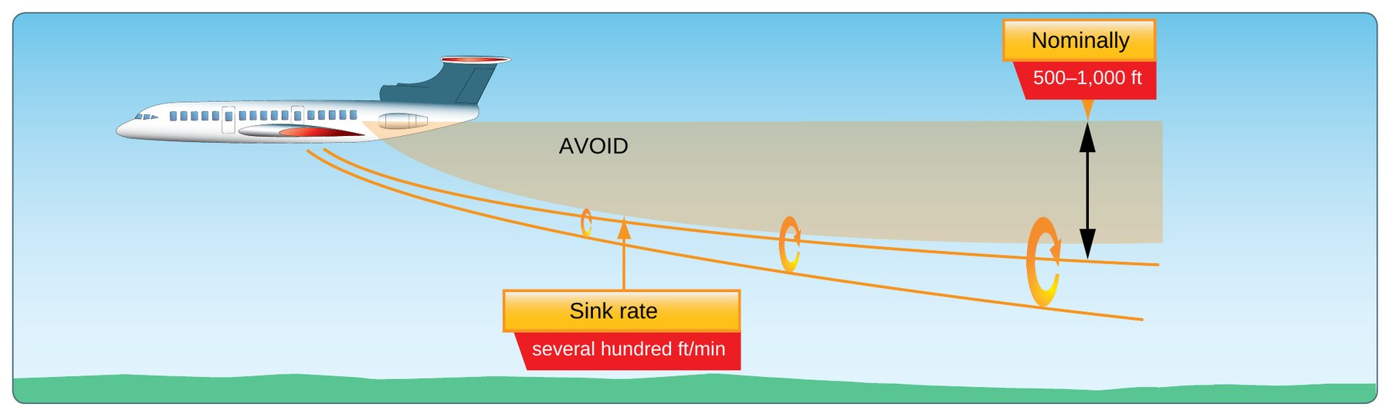
Wake Turbulence Precautions
AI.II.D.K6
Landing: stay above, land beyond
Departing: rotate before them
Climb above their path
En route: avoid below and behind
Landing behind a larger aircraft on the same runway: stay at or above its final approach path, note its touchdown point, and land beyond it (AIM 7-4-6).
Departing behind a larger aircraft: note its rotation point, rotate prior to it, and climb above its climb path until turning clear (AIM 7-4-6).
After a larger aircraft does a low approach, missed approach, or touch-and-go, wait at least 2 minutes before your takeoff or landing (AIM 7-4-6).
En route: avoid flight below and behind a large aircraft's path. Avoid following within 1,000 feet below (AIM 7-4-6, PHAK 5-9).
Whether or not ATC gives a wake turbulence caution, the pilot is expected to adjust to avoid wake encounters (AIM 7-4-6).
MEMORY AID
Land beyond, lift off before, stay above.
REAL WORLD SCENARIO
You are cleared for takeoff right after a regional jet departs. Ask your student where they plan to rotate and which way to turn after takeoff.
Source: AIM 7-4-6, PHAK 5-9
22
Notes:
Rule of thumb: stay above the bigger airplane's path. Land past its touchdown point, lift off before its rotation point.

Slide 23
Quick Check
AI.II.D.K6
1
When are wingtip vortices strongest?
Answer: When the generating aircraft is heavy, clean, and slow (PHAK 5-9).
2
Landing behind a larger aircraft on the same runway: where do you touch down?
Answer: Beyond its touchdown point, staying at or above its approach path (AIM 7-4-6).
3
A larger aircraft just did a touch-and-go. How long do you wait?
Answer: At least 2 minutes (AIM 7-4-6).
NEXT UP
Next up, stability. We know the forces. Why does the airplane stay balanced when a gust hits it?
Source: PHAK 5-9, AIM 7-4-4, AIM 7-4-6
23
Notes:
Ask each question and let the student answer before showing the answer. Q1: When are wingtip vortices strongest? A: When the generating aircraft is heavy, clean, and slow (PHAK 5-9). Q2: Landing behind a larger aircraft on the same runway: where do you touch down? A: Beyond its touchdown point, staying at or above its approach path (AIM 7-4-6). Q3: A larger aircraft just did a touch-and-go. How long do you wait? A: At least 2 minutes (AIM 7-4-6).

Slide 24
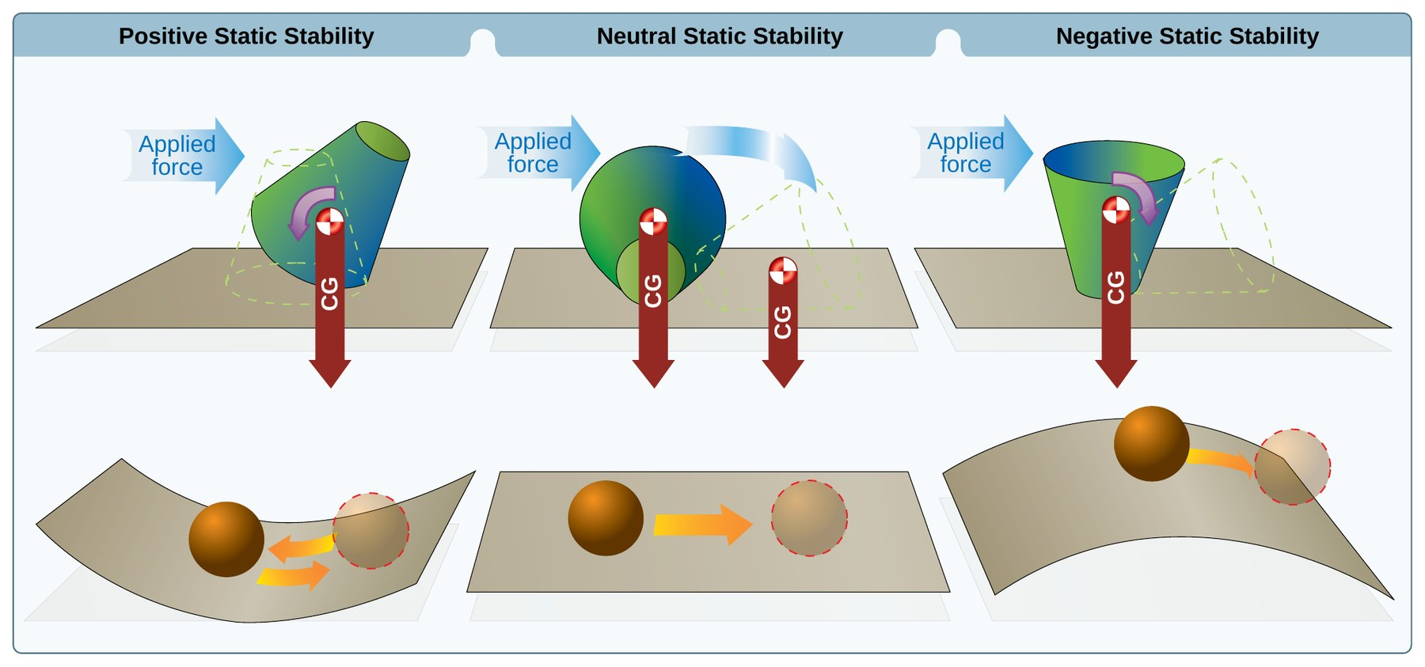
Step 4 of 6 | AI.II.D.K2
Stability, Maneuverability, Controllability
What you will learn
Static and dynamic stability
Pitch, roll, and yaw stability
Maneuverability and controllability
How CG changes them
Coming from step 3: we know what forces act. Now, why does the airplane stay in balance when a gust hits it?
Source: PHAK 5-14 to 5-19
24
Notes:
Section: Stability, Maneuverability, Controllability. Coming from step 3: we know what forces act. Now, why does the airplane stay in balance when a gust hits it?

Slide 25
Definition: Stability
AI.II.D.K2
STABILITY
“Stability is the inherent quality of an aircraft to correct for conditions that may disturb its equilibrium and to return to or to continue on the original flight path. It is primarily an aircraft design characteristic.”
IN PLAIN WORDS
Static stability is the first reaction (ball in a bowl rolls back). Dynamic stability is what happens over time (the bounces get smaller).
MEMORY AID
Bowl, table, hill: positive, neutral, negative.
Source: PHAK 5-14, PHAK Fig 5-21
25
Notes:
Use your bowl method from the whiteboard: bowl is positive, flat is neutral, hill is negative.

Slide 26
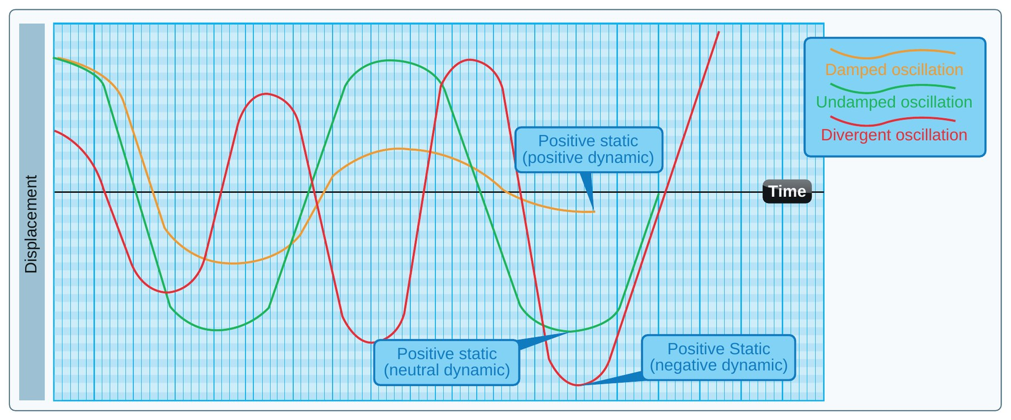
Dynamic Stability
AI.II.D.K2
Response over time
Positive: swings get smaller
Neutral: swings stay the same
Negative: swings grow
Dynamic stability is the aircraft response over time. Positive: motion decreases. Neutral: neither decreases nor increases (like a worn shock absorber). Negative: motion increases (PHAK 5-15).
In flight demonstration: trim for hands-off level flight and give the controls a slight push. If the oscillations gradually stop, the airplane has positive stability; if they continue, neutral; if they increase, unstable (PHAK 5-17).
Source: PHAK 5-14, PHAK 5-15, PHAK 5-17, PHAK Fig 5-22
26
Notes:
Demo from the PHAK: trim for hands off, give a small push, then let go and watch the oscillations.

Slide 27
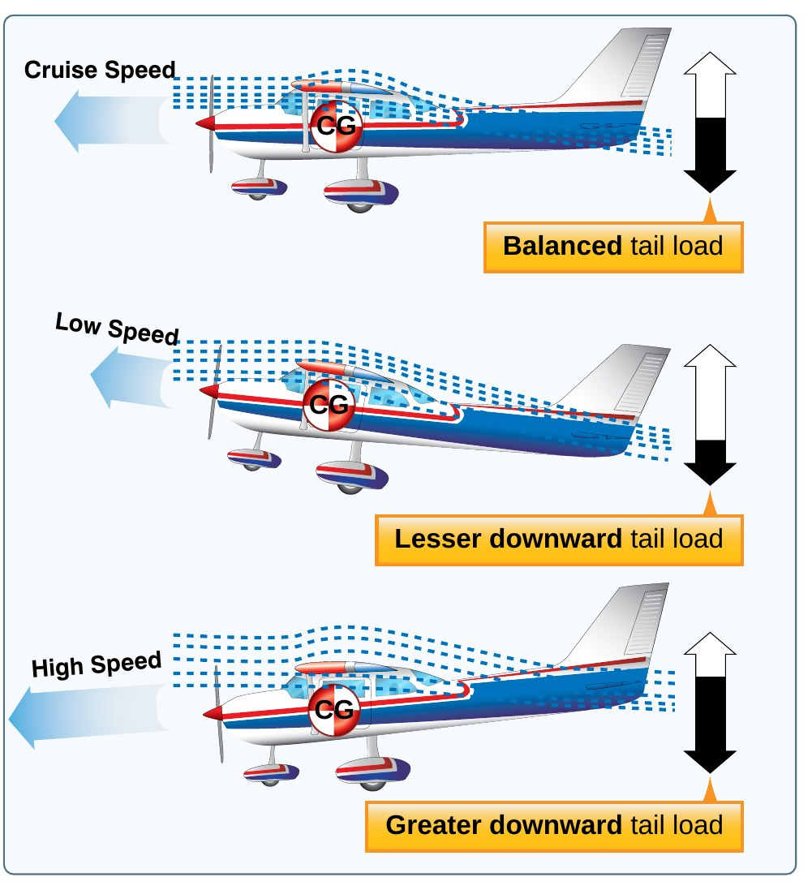
Longitudinal Stability (Pitch)
AI.II.D.K2
About the lateral axis
CG ahead of center of lift
Tail pushes down to balance
Slow down: nose drops
Longitudinal stability is stability about the lateral axis: pitch (PHAK 5-15).
It depends on the location of the wing and the horizontal tail relative to the CG, and on the size of the tail (PHAK 5-15).
Most airplanes have the center of lift behind the CG, so they are nose heavy. The horizontal stabilizer makes a downward force to balance it (PHAK 5-16).
If speed decreases, downwash on the tail decreases, the nose pitches down, and airspeed increases again. This is why the C172S tends to return to its trimmed speed (PHAK 5-16).
KNOW THIS FOR THE CHECKRIDE
CG ahead of the center of lift plus a tail-down force: the airplane tries to return to a safe attitude (PHAK 5-17).
Source: PHAK 5-15, PHAK 5-16, PHAK Fig 5-24
27
Notes:
The airplane is designed nose heavy. The tail pushes down. Slow down and the tail pushes less, so the nose drops and the airplane gains speed back.

Slide 28
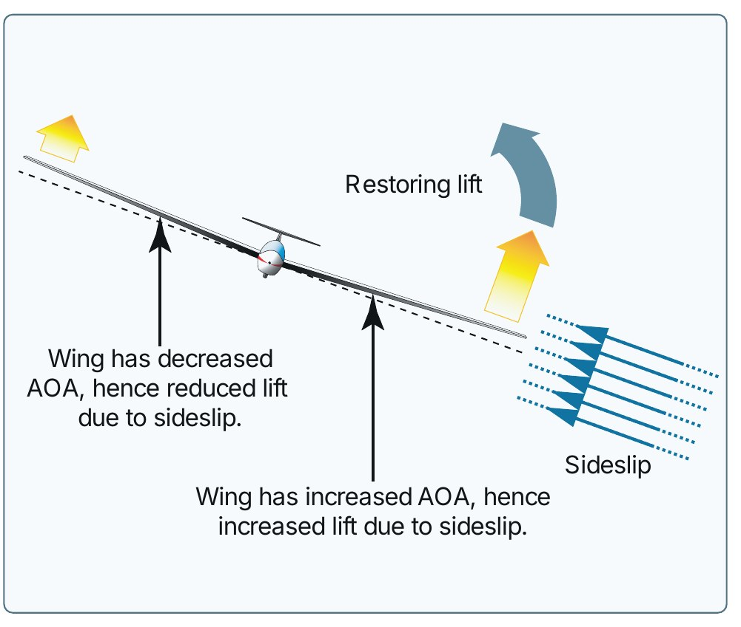
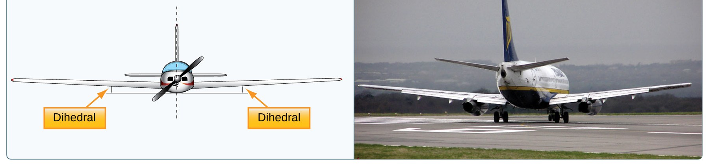
Lateral Stability (Roll)
AI.II.D.K2
About the longitudinal axis
Dihedral, sweepback, keel effect
Low wing gets more AOA
High wing helps (C172S)
Lateral stability is stability about the longitudinal axis: roll. Four design factors: dihedral, sweepback, keel effect, and weight distribution (PHAK 5-17).
Dihedral: when a gust rolls the airplane, it sideslips. The wing slipping into the wind has a higher AOA and more lift, which rolls the airplane back (PHAK 5-18).
A high wing airplane like the C172S gets lateral stability from keel effect: the fuselage hangs below the wing like a pendulum (PHAK 5-18).
Source: PHAK 5-17, PHAK 5-18, PHAK G-10, PHAK Fig 5-29
28
Notes:
When a wing drops, the airplane slips toward it. The low wing meets the air at a higher AOA, gets more lift, and rises.

Slide 29
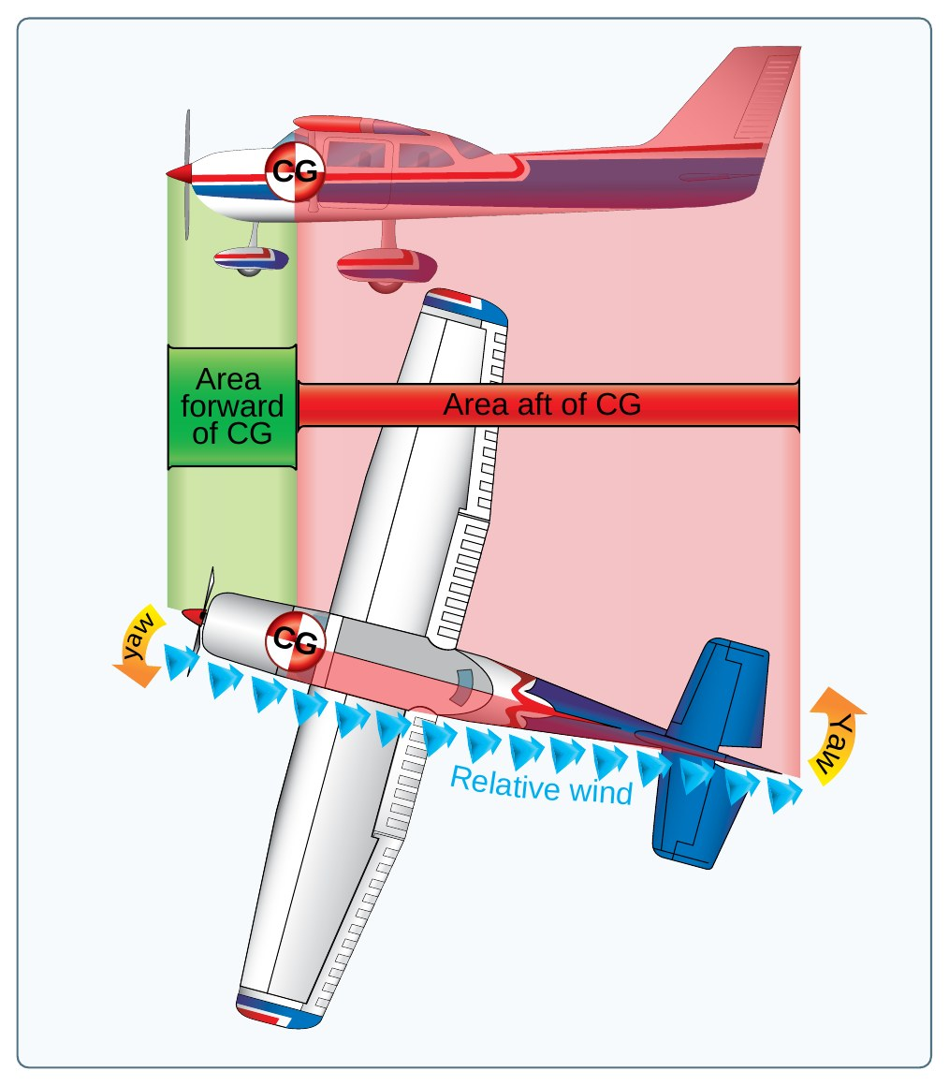
Directional Stability (Yaw)
AI.II.D.K2
About the vertical axis
Vertical fin acts like arrow feathers
More side area behind the CG
Weathervanes into the wind
Directional stability is stability about the vertical axis: yaw. It is the most easily achieved stability in design (PHAK 5-19).
The vertical fin and fuselage sides aft of the CG make the airplane act like a weather vane or arrow, pointing into the relative wind. The farther aft and larger the fin, the greater the directional stability (PHAK 5-19).
MEMORY AID
Weather vane or arrow: more area behind the pivot point.
Source: PHAK 5-19, PHAK Fig 5-32
29
Notes:
Like a weather vane or the feathers on an arrow: more area behind the pivot point keeps the nose pointed into the relative wind.

Slide 30
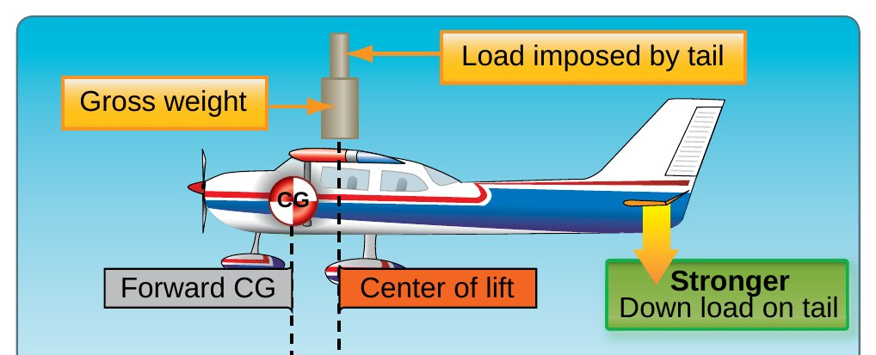
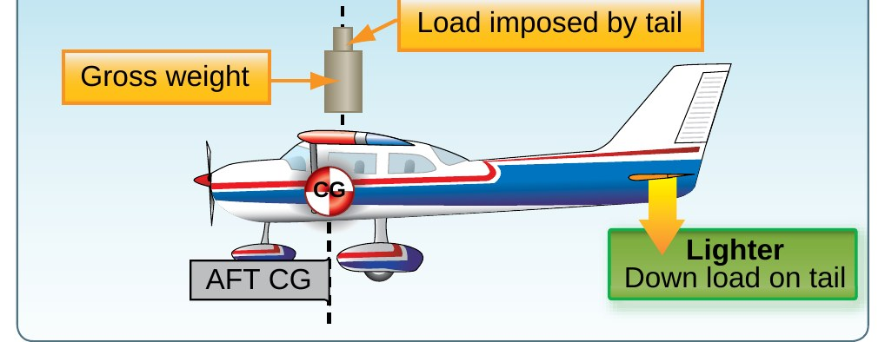
Definitions: Maneuverability and Controllability
AI.II.D.K2
MANEUVERABILITY
“the quality of an aircraft that permits it to be maneuvered easily and to withstand the stresses imposed by maneuvers.”
CONTROLLABILITY
“the capability of an aircraft to respond to the pilot's control, especially with regard to flight path and attitude.”
IN PLAIN WORDS
Forward CG: more stable, higher stall speed, heavier controls. Aft CG: less stable, lighter controls, harder stall recovery.
Source: PHAK 5-15, PHAK 5-43, PHAK 5-44
30
Notes:
More stability usually means less maneuverability. CG is the part the pilot controls, and it changes all three.

Slide 31
Quick Check
AI.II.D.K2
1
The nose returns toward level after a push, then the swings die out. Static and dynamic stability?
Answer: Positive static and positive dynamic (PHAK 5-14, PHAK 5-17).
2
Which axis is pitch stability about?
Answer: The lateral axis (PHAK 5-15).
3
What makes a C172S laterally stable?
Answer: Dihedral and keel effect from the high wing (PHAK 5-18).
NEXT UP
Next up, turning tendencies. The airplane is built stable, so what keeps pulling the nose to the left?
Source: PHAK 5-14 to 5-19
31
Notes:
Ask each question and let the student answer before showing the answer. Q1: The nose returns toward level after a push, then the swings die out. Static and dynamic stability? A: Positive static and positive dynamic (PHAK 5-14, PHAK 5-17). Q2: Which axis is pitch stability about? A: The lateral axis (PHAK 5-15). Q3: What makes a C172S laterally stable? A: Dihedral and keel effect from the high wing (PHAK 5-18).

Slide 32
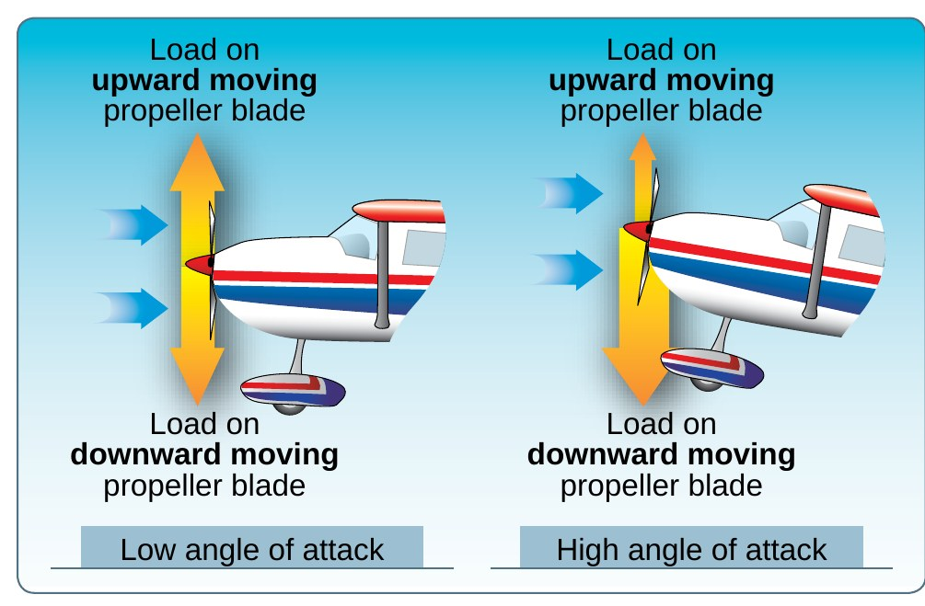
Step 5 of 6 | AI.II.D.K3
Turning Tendencies
What you will learn
Torque reaction
Corkscrewing slipstream
Gyroscopic precession
P-factor
Coming from step 4: the airplane is built to be stable, but the engine and propeller keep trying to pull it left.
Source: PHAK 5-30 to 5-32
32
Notes:
Section: Turning Tendencies. Coming from step 4: the airplane is built to be stable, but the engine and propeller keep trying to pull it left.

Slide 33
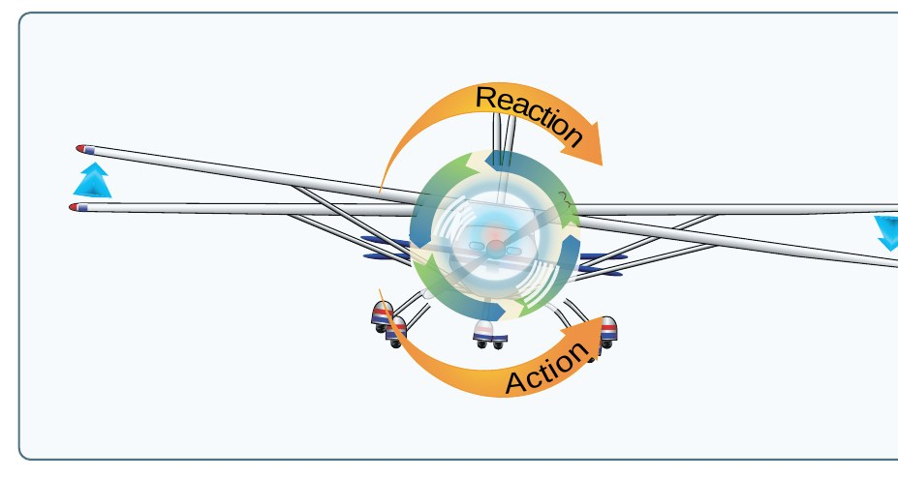
Turning Tendencies: Torque Reaction
AI.II.D.K3
Four elements make up "torque"
Prop turns clockwise (pilot view)
Airplane rolls left in reaction
On ground: left yaw from tire drag
The left turning tendency called "torque" is made of four elements: torque reaction, corkscrewing slipstream, gyroscopic action, and P-factor (PHAK 5-30, PHAK 5-31).
Torque reaction uses Newton's Third Law: as the propeller turns one way, the airplane tries to roll the other way. Most U.S. engines turn the prop clockwise as seen from the pilot's seat (PHAK 5-31).
On the takeoff roll, more weight on the left main gear makes more friction and a left turning moment, corrected with rudder (PHAK 5-31).
KNOW THIS FOR THE CHECKRIDE
Four parts of "torque": torque reaction, slipstream, gyroscopic precession, P-factor.
Source: PHAK 5-30, PHAK 5-31, PHAK Fig 5-47
33
Notes:
Newton again. The engine spins the prop one way, so the airplane wants to roll the other way. On the takeoff roll, that puts weight on the left tire.

Slide 34
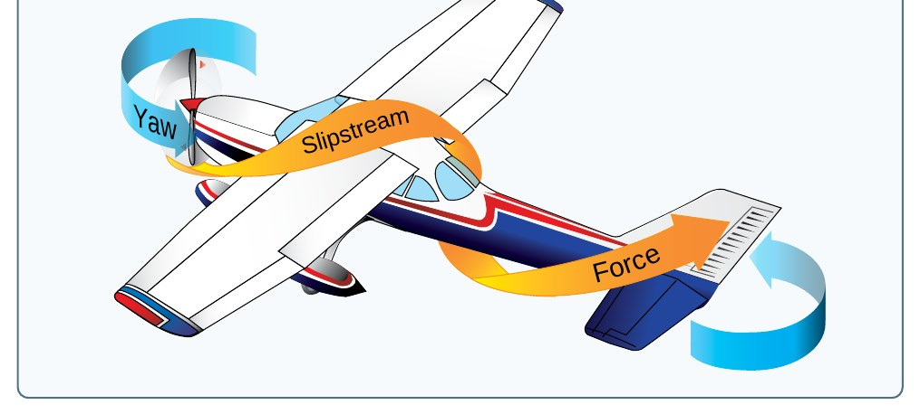
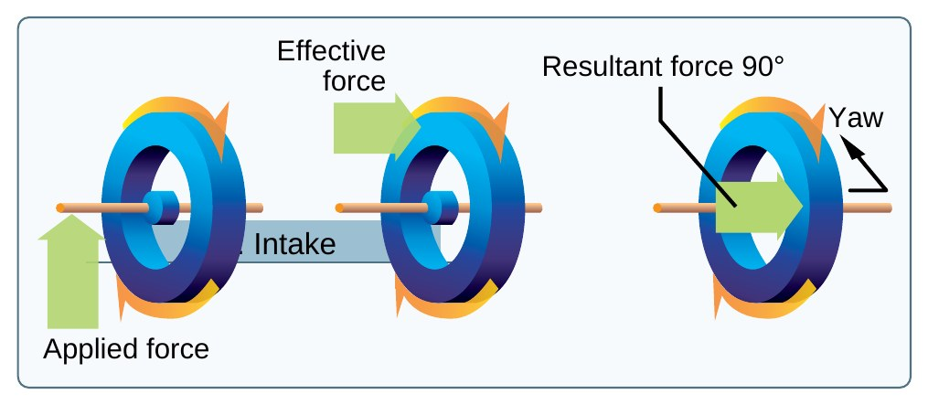
Turning Tendencies: Slipstream and Gyroscopic
AI.II.D.K3
Slipstream hits left side of tail
Strongest: high power, low speed
Precession: force acts 90 degrees ahead
Mostly tailwheel, when tail rises
Corkscrew effect: the prop gives the slipstream a spiraling rotation. At high power and low speed it strikes the vertical fin and yaws the airplane (PHAK 5-31).
Gyroscopic precession: a force applied to a spinning propeller takes effect 90 degrees ahead in the direction of rotation (PHAK 5-31). Most prominent in tailwheel airplanes when the tail is raised on takeoff, causing a left yaw (PHAK 5-32).
Source: PHAK 5-31, PHAK 5-32, PHAK Fig 5-48, PHAK Fig 5-49
34
Notes:
Spiraling slipstream wraps around and hits the left side of the fin, yawing the nose left. Gyroscopic precession matters most when a tailwheel pilot raises the tail.

Slide 35
Turning Tendencies: P-Factor
AI.II.D.K3
High AOA (climb, slow flight)
Down-going blade takes bigger bite
More thrust on the right side
Nose yaws left: add right rudder
At a high AOA, the downward moving blade on the right has a greater "bite" than the upward moving blade. The center of thrust moves to the right of the prop disc, yawing the nose left (PHAK 5-32).
The four elements change with flight condition. The pilot must use the controls to compensate in every phase (PHAK 5-32).
EXAMPLE
C172S: full power climb at Vy. Feel the nose wanting to go left and hold right rudder to keep the ball centered.
Source: PHAK 5-32, PHAK Fig 5-51
35
Notes:
In a climb, the right side of the prop disk makes more thrust than the left. That pulls the nose left. Right rudder fixes it.

Slide 36
Quick Check
AI.II.D.K3
1
Name the four turning tendencies.
Answer: Torque reaction, corkscrewing slipstream, gyroscopic precession, P-factor (PHAK 5-31).
2
Gyroscopic precession: where does the resulting force act?
Answer: 90 degrees ahead in the direction of rotation (PHAK 5-31).
3
In a full power climb, which way does the nose yaw and what fixes it?
Answer: Left. Right rudder (PHAK 5-32).
NEXT UP
Next up, load factors. Now that we can control it, how hard can we maneuver before it stalls or breaks?
Source: PHAK 5-31, PHAK 5-32
36
Notes:
Ask each question and let the student answer before showing the answer. Q1: Name the four turning tendencies. A: Torque reaction, corkscrewing slipstream, gyroscopic precession, P-factor (PHAK 5-31). Q2: Gyroscopic precession: where does the resulting force act? A: 90 degrees ahead in the direction of rotation (PHAK 5-31). Q3: In a full power climb, which way does the nose yaw and what fixes it? A: Left. Right rudder (PHAK 5-32).

Slide 37
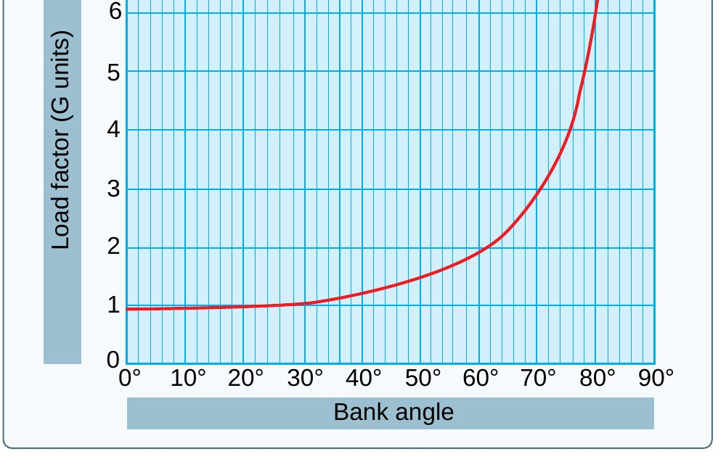
Step 6 of 6 | AI.II.D.K5
Load Factors
What you will learn
Load factor and design limits
Load factor in turns
Load factor and stall speed
Maneuvering speed
Coming from step 5: once we can control the airplane, how hard can we maneuver it before something breaks or stalls?
Source: PHAK 5-33 to 5-36, POH 2-4, POH 2-11
37
Notes:
Section: Load Factors. Coming from step 5: once we can control the airplane, how hard can we maneuver it before something breaks or stalls?

Slide 38
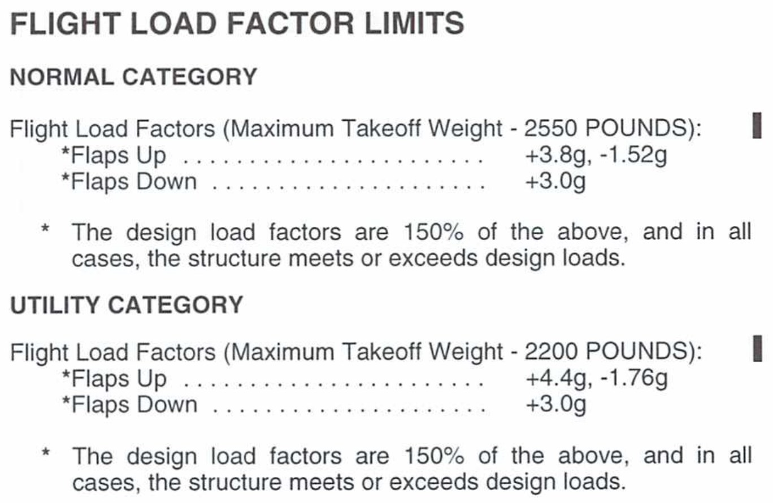
Definition: Load Factor
AI.II.D.K5
LOAD FACTOR
“The ratio of a specified load to the total weight of the aircraft.”
IN PLAIN WORDS
Load factor is measured in Gs. 3 Gs means the structure carries three times the airplane's weight. C172S normal category: +3.8 to -1.52 Gs flaps up.
Source: PHAK G-18, PHAK 5-33, PHAK 5-34, POH 2-11
38
Notes:
Your whiteboard numbers are right: normal +3.8 and -1.52, utility +4.4 and -1.76. Flaps down limit is +3.0.

Slide 39
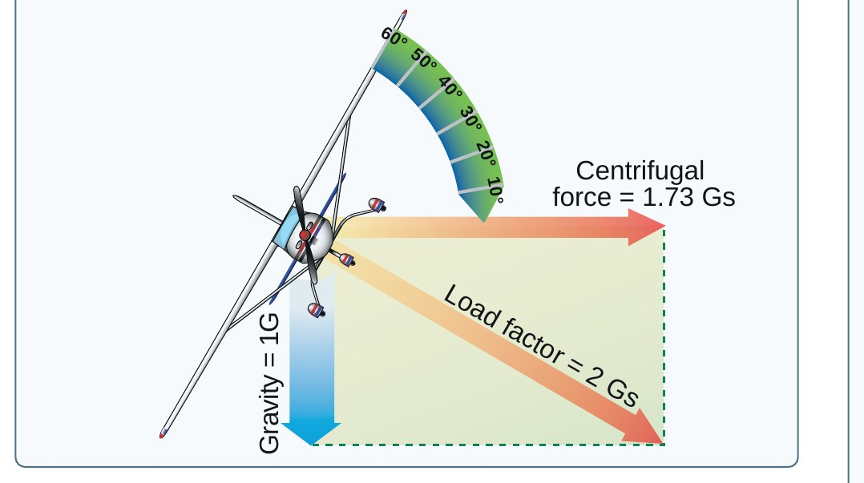
Load Factor in Turns
AI.II.D.K5
60 degree bank: 2 Gs
Rises fast past 45 to 50 degrees
About 70 to 75 degrees: yield point
Wing must make that much lift
In a coordinated, level turn, the load factor results from centrifugal force and weight (PHAK 5-34).
At 60 degrees of bank, load factor is 2 Gs. Load factor increases at a terrific rate after about 45 or 50 degrees (PHAK 5-34).
The yield factor of the average light plane is reached at about 70 to 75 degrees of bank (PHAK 5-36).
KNOW THIS FOR THE CHECKRIDE
60 degrees of bank = 2 Gs. Past 45 to 50 degrees it rises very fast (PHAK 5-34).
Source: PHAK 5-34, PHAK 5-36, PHAK Fig 5-53
39
Notes:
In a level 60 degree bank the wing must lift twice the weight of the airplane. Past 45 degrees the curve shoots up.

Slide 40
Load Factor and Stall Speed
AI.II.D.K5
Stall speed rises with load
Square root of load factor
C172S: 48 KIAS level
68 KIAS at 60 degrees bank
Stalling speed increases in proportion to the square root of the load factor. A 50 knot stalling speed becomes 100 knots at 4 Gs (PHAK 5-35).
C172S, flaps up, 2,550 lb: 48 KIAS at 0 degrees, 52 at 30, 57 at 45, and 68 at 60 degrees of bank (POH Fig 5-3).
Altitude loss during stall recovery may be as much as 230 feet (POH Fig 5-3).
Source: PHAK 5-35, POH Fig 5-3
40
Notes:
This is why steep turns near the ground are dangerous. The same C172S that stalls at 48 knots wings level stalls at 68 knots in a 60 degree bank.

Slide 41
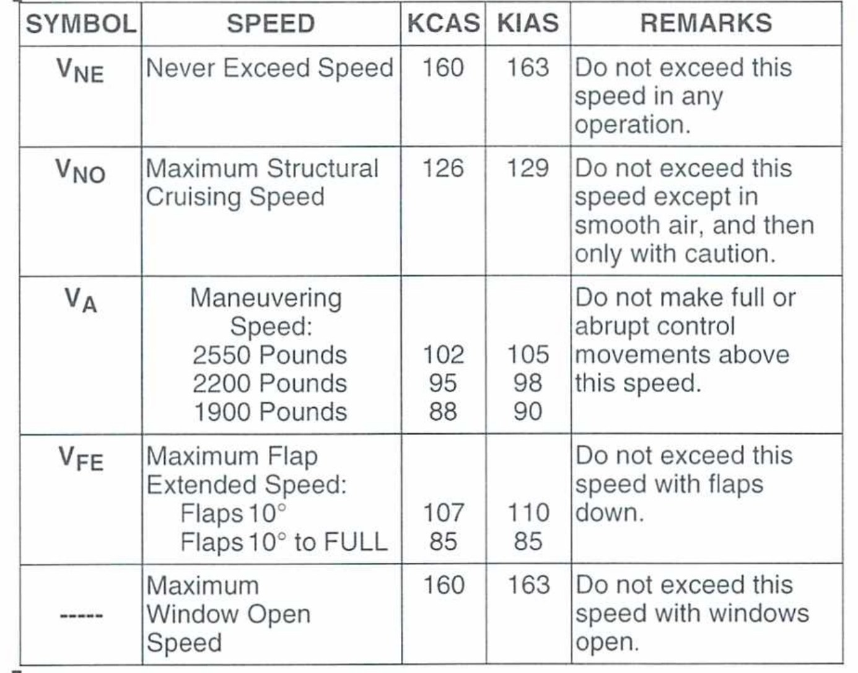
Maneuvering Speed (VA)
AI.II.D.K5
One full input, one axis
C172S: 105 KIAS at 2,550 lb
Lighter airplane: lower VA
No protection from combined inputs
VA is the speed below which you can move a single flight control, one time, to its full deflection, for one axis only, in smooth air, without risk of damage (PHAK 5-35).
Operating at or below VA does not provide structural protection against multiple full control inputs in one axis or full control inputs in more than one axis at the same time (PHAK 5-35).
C172S: 105 KIAS at 2,550 lb, 98 KIAS at 2,200 lb, 90 KIAS at 1,900 lb (POH 2-4).
Avoid rapid and large alternating control inputs; they may cause structural failure at any speed, including below VA (PHAK 5-36).
KNOW THIS FOR THE CHECKRIDE
VA is not protection against multiple full inputs or full inputs in more than one axis at once (PHAK 5-35).
Source: PHAK 5-35, PHAK 5-36, POH 2-4
41
Notes:
Your note is right: VA does not protect you from multiple full inputs or inputs in more than one axis. VA also goes down as weight goes down.

Slide 42
Quick Check
AI.II.D.K5
1
Load factor in a level 60 degree bank?
Answer: 2 Gs (PHAK 5-34).
2
C172S flaps up stall speed: wings level vs. 60 degrees of bank?
Answer: 48 KIAS vs. 68 KIAS (POH Fig 5-3).
3
C172S VA at 2,550 lb, and does it protect against two full inputs at once?
Answer: 105 KIAS. No (POH 2-4, PHAK 5-35).
NEXT UP
Next up, risk management. Each principle comes with a risk. Let us manage them and plan how to teach this.
Source: PHAK 5-34, PHAK 5-35, POH 2-4, POH Fig 5-3
42
Notes:
Ask each question and let the student answer before showing the answer. Q1: Load factor in a level 60 degree bank? A: 2 Gs (PHAK 5-34). Q2: C172S flaps up stall speed: wings level vs. 60 degrees of bank? A: 48 KIAS vs. 68 KIAS (POH Fig 5-3). Q3: C172S VA at 2,550 lb, and does it protect against two full inputs at once? A: 105 KIAS. No (POH 2-4, PHAK 5-35).

Slide 43
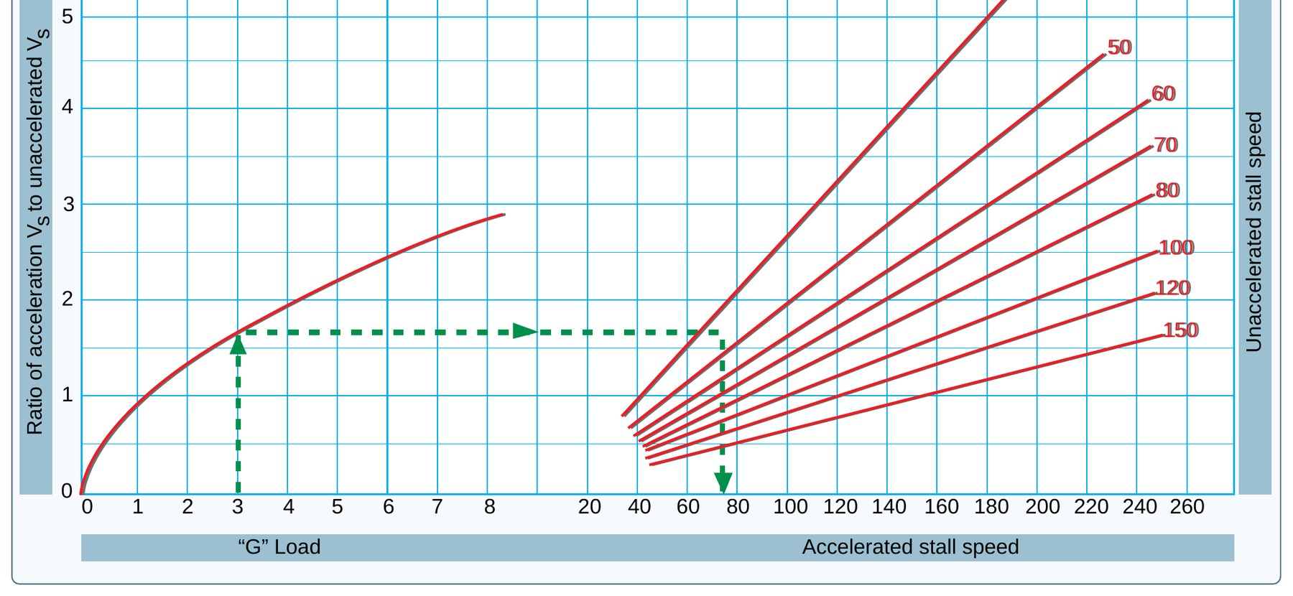
AI.II.D.R1, S1
Risk Management and Teaching It
What you will learn
Stalls from load factor
Wake, turning tendencies, spirals
Teaching three elements in flight
Putting it together: every principle comes with a risk. Here is how to manage each one and how to teach it.
Source: PHAK 5-20, PHAK 5-35, AIM 7-4-6
43
Notes:
Section: Risk Management and Teaching It. Putting it together: every principle comes with a risk. Here is how to manage each one and how to teach it.

Slide 44
Risk: Stalls From Load Factor
AI.II.D.R1
Steep turns raise stall speed
Base to final overshoot trap
Keep bank shallow near ground
Unload to recover
Knowing load factors and VA helps prevent two of the most serious accident types: stalls from steep turns or excessive maneuvering near the ground, and structural failures from violent maneuvers or loss of control (PHAK 5-36).
Mitigation: plan the pattern to avoid overshoots, keep bank angles moderate near the ground, go around instead of tightening the turn, and reduce AOA at the first sign of a stall.
REAL WORLD SCENARIO
Your student overshoots the turn from base to final, steepens to 45 degrees, and pulls back. Ask what just happened to the stall speed and what they should do instead.
Source: PHAK 5-35, PHAK 5-36, POH Fig 5-3
44
Notes:
Scenario: overshooting base to final, the pilot steepens the bank and pulls. Load factor goes up, stall speed goes up, and the airplane is close to the ground.

Slide 45
Risk: Wake, Turning Tendencies, Spirals
AI.II.D.R1
Wake: plan your rotation point
Left yaw: lead with right rudder
Spiral: level wings, then pull
Know the airplane's numbers
Wake turbulence: pick a rotation point before a larger aircraft's, and wait 2 minutes after a larger aircraft low approach or touch-and-go (AIM 7-4-6).
Turning tendencies: anticipate left yaw on takeoff and in climbs; use right rudder to stay on centerline and coordinated (PHAK 5-32).
Spiral instability: in a spiral, pulling back before leveling the wings only tightens the turn and raises load factor. Improper recovery from spirals leading to structural failure has contributed to many general aviation fatalities (PHAK 5-20).
Source: AIM 7-4-6, PHAK 5-20, PHAK 5-32
45
Notes:
Every principle has a risk. Wake can roll a C172S. Turning tendencies can drift you off centerline. A spiral pull without leveling the wings overstresses the airplane.

Slide 46
Teaching It: Three Elements in Flight
AI.II.D.S1
Stability: trim, push, let go
P-factor: climb, feel left yaw
Load factor: 45 and 60 degree turns
Debrief each with the student
S1 requires delivering instruction on at least three elements from K1 to K6. Example plan in the C172S at a safe altitude:
Stability (K2): trim for hands-off level flight, push the nose down slightly, release, and watch the oscillations damp out (PHAK 5-17).
Turning tendency (K3): in a full power climb, show the left yaw and the right rudder needed (PHAK 5-32).
Load factor (K5): fly 45 and 60 degree turns, feel the G load, and relate it to the higher stall speeds in the POH table (POH Fig 5-3).
Source: ACS AI.II.D.S1, PHAK 5-17, PHAK 5-32, POH Fig 5-3
46
Notes:
The ACS asks you to deliver instruction on at least three of K1 to K6. These are three easy ones to show in the C172S, all at a safe altitude.

Slide 47
Common Errors
AI.II.D
Saying all four forces are equal
Stall "from low speed"
Drag "inversely" (not squared)
Treating VA as full protection
"All four forces are equal": opposing forces cancel, but lift and weight are larger than thrust and drag (PHAK 5-2).
"Stalls happen at low speed": stalls happen when the critical AOA is exceeded, at any airspeed (PHAK G-9).
"Induced drag varies inversely with speed": it varies inversely with the square of the airspeed (PHAK 5-8).
"Below VA I am safe": VA protects only against one full input in one axis (PHAK 5-35).
Source: PHAK 5-2, PHAK 5-8, PHAK G-9, PHAK 5-35
47
Notes:
These are the misconceptions students bring most often. Correct them early.

Slide 48
Review Questions
AI.II.D
State Bernoulli's Principle
What causes a stall?
Load factor at 60 degrees?
Departing behind a heavy: where rotate?
Source: PHAK 4-6, PHAK G-9, PHAK 5-34, AIM 7-4-6
48
Notes:
Answers: velocity up, pressure down. Exceeding the critical AOA. 2 Gs. Before the larger aircraft's rotation point.

Slide 49
References
AI.II.D
PHAK Chapters 4 and 5
AIM 7-4
C172S POH Sections 2 and 5
FAA-S-ACS-25
Source: See lesson plan for full list
49
Notes:
All numbers came from these sources. The C172S pages are a training copy.

